Slide 1
KAME:knowledge-based Attention Model for Diagnosis Prediction in Healthcare
Source : CIKM 2018
Advisor : JIA-LING KOH
Speaker : YI-CHENG HUNG
Date:2018/12/18

Slide 2
Outline
Introduction
Method
Experiment
Conclusion

Slide 3
Outline
Introduction
Method
Experiment
Conclusion

Slide 4
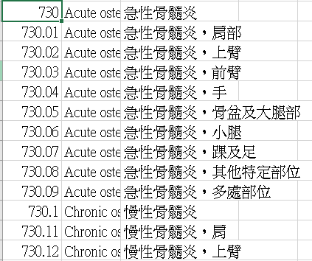
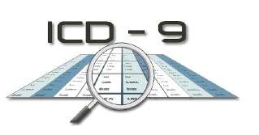
Introduction
Electronic Health Records

Slide 5
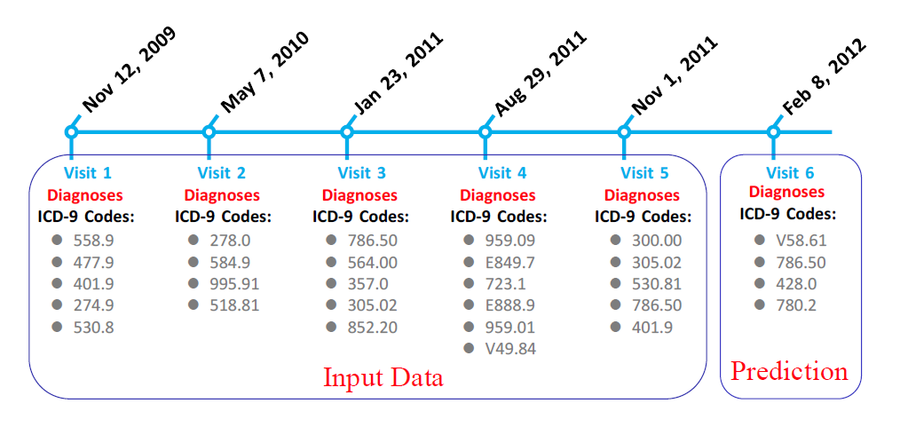
Introduction-task
Diagnosis Prediction
Utilizing historical EHR data of individuals to predict the next visit information

Slide 6
Outline
Introduction
Method
Experiment
Conclusion

Slide 7
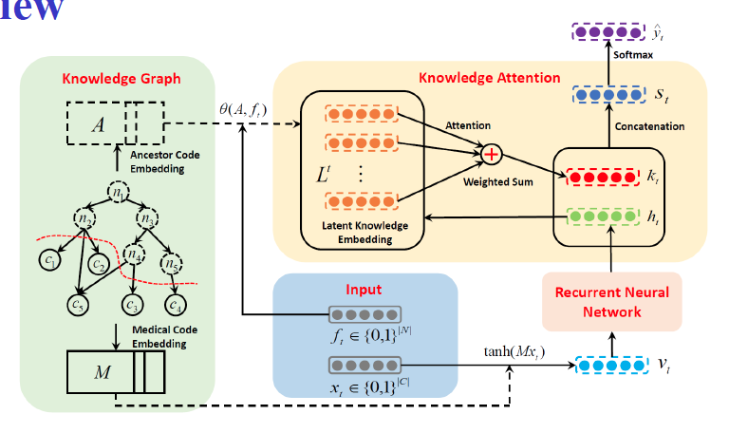
Overview

Slide 8
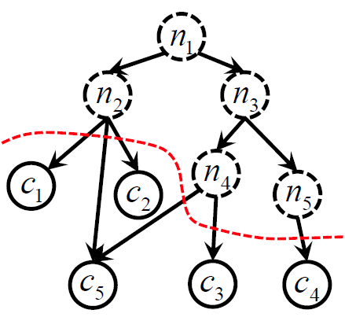
Notation
Inputs
Knowledge graph 𝒢 = {𝒞,𝒩}.
Visit record and Ancestor set (high-level)
𝑉t =
𝑄t =

Slide 9
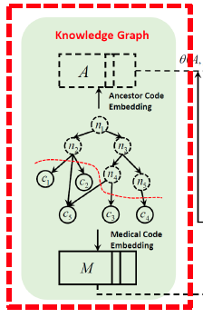
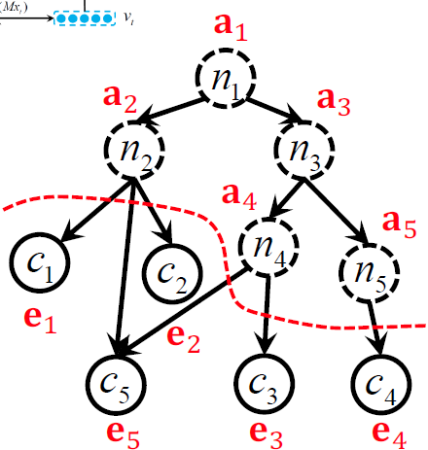
Knowledge Graph Embedding
Graph Attention
Leaf code 𝐦1 = GRAM(𝐞1, 𝐚1, 𝐚2,)
Leaf Code Matrix M
Ancestor Code Matrix A

Slide 10
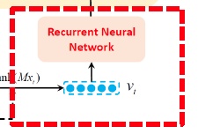
Visit Embedding & Recurrent Neural Network
Visit Embedding
𝐯_{t} = tanh (𝐌𝐱_{t})
Gated Recurrent Unit (GRU)
𝐡_{t} = GRU(𝐯_{t};𝛀)

Slide 11
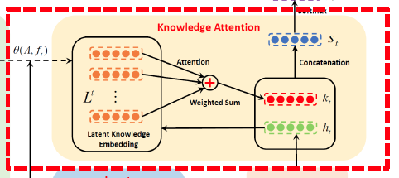
Knowledge-based Attention Mechanism
Latent Knowledge Embedding
Example:
Ancestor set 𝑄_{t} = {𝑛₁,𝑛₂, 𝑛₃, 𝑛₅} , f_{t} ={1,1,1,0,1} , 𝐟_{t1} =1 and 𝐟_{t4} = 0.
Attention

Slide 12
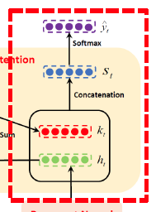
Knowledge-based Prediction
Knowledge Attentional Vector
𝐬_{t} = [𝐡_{t}; 𝐤_{t}]
Prediction
𝐲_{j} = Softmax(𝐖_{c}𝐬_{t})+𝐛_{c})

Slide 13
Outline
Introduction
Method
Experiment
Conclusion

Slide 14
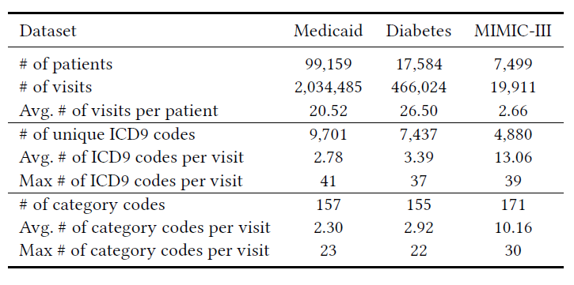
Dataset
醫療補助
糖尿病
重症監護室
Evaluation Measures
Visit-level precision@k
the correct medical codes in top k/ min(k, |yt |)
|yt | is the number of category labels in the (t +1)-th visit.
Code-level accuracy@k
the number of correct label predictions/ the total number of label predictions

Slide 15
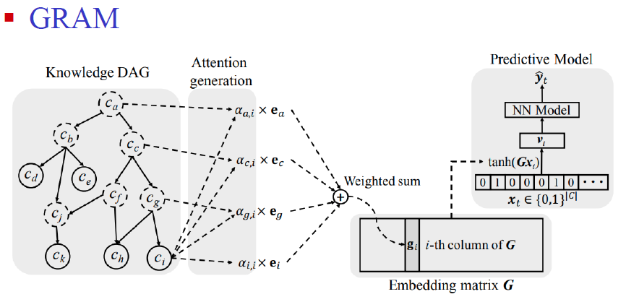
Baseline Approaches

Slide 16
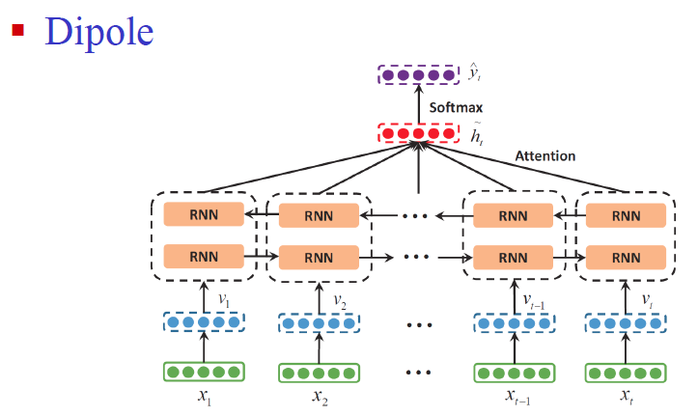
Baseline Approaches

Slide 17
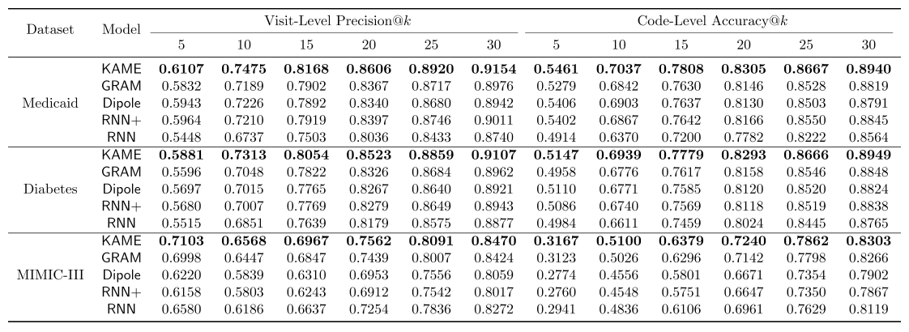
Results on three datasets

Slide 18
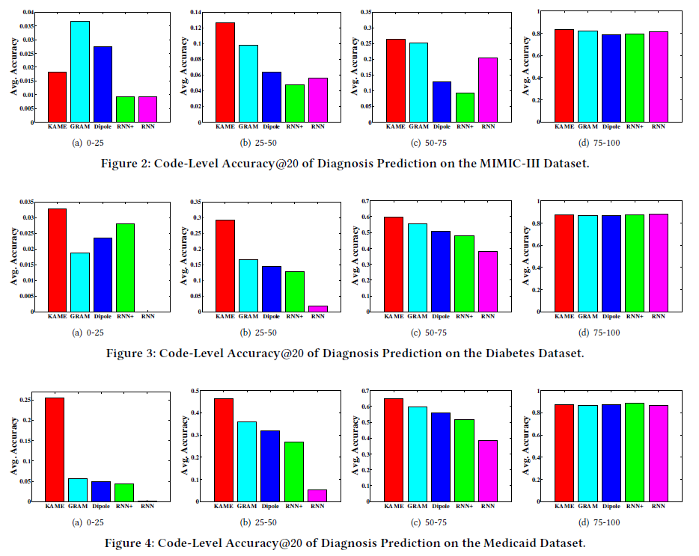
Data sufficiency analysis

Slide 19
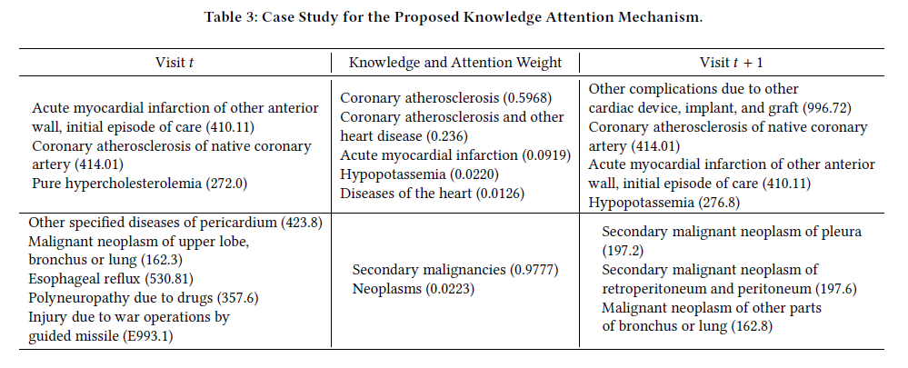
Case Study for Knowledge Attention

Slide 20
Interpretability Analysis

Slide 21
CONCLUSION
We propose KAME, an end-to-end, accurate and robust model to accurately predict patients' future visit information with medical Ontologies.
We design a novel knowledge-level attention mechanism, which significantly helps the proposed KAME to improve the predictive performance.

